Slide 1

Personalize Consumer Experience with Dynamics 365
Presenter: Krishnam Nagapuri

Slide 2
Personalize Consumer Experience with Dynamics 365
March 11th, 2019

Slide 3
By 2020,
customer experience will overtake price and product as the key brand differentiator.
Source: Gartner

Slide 4

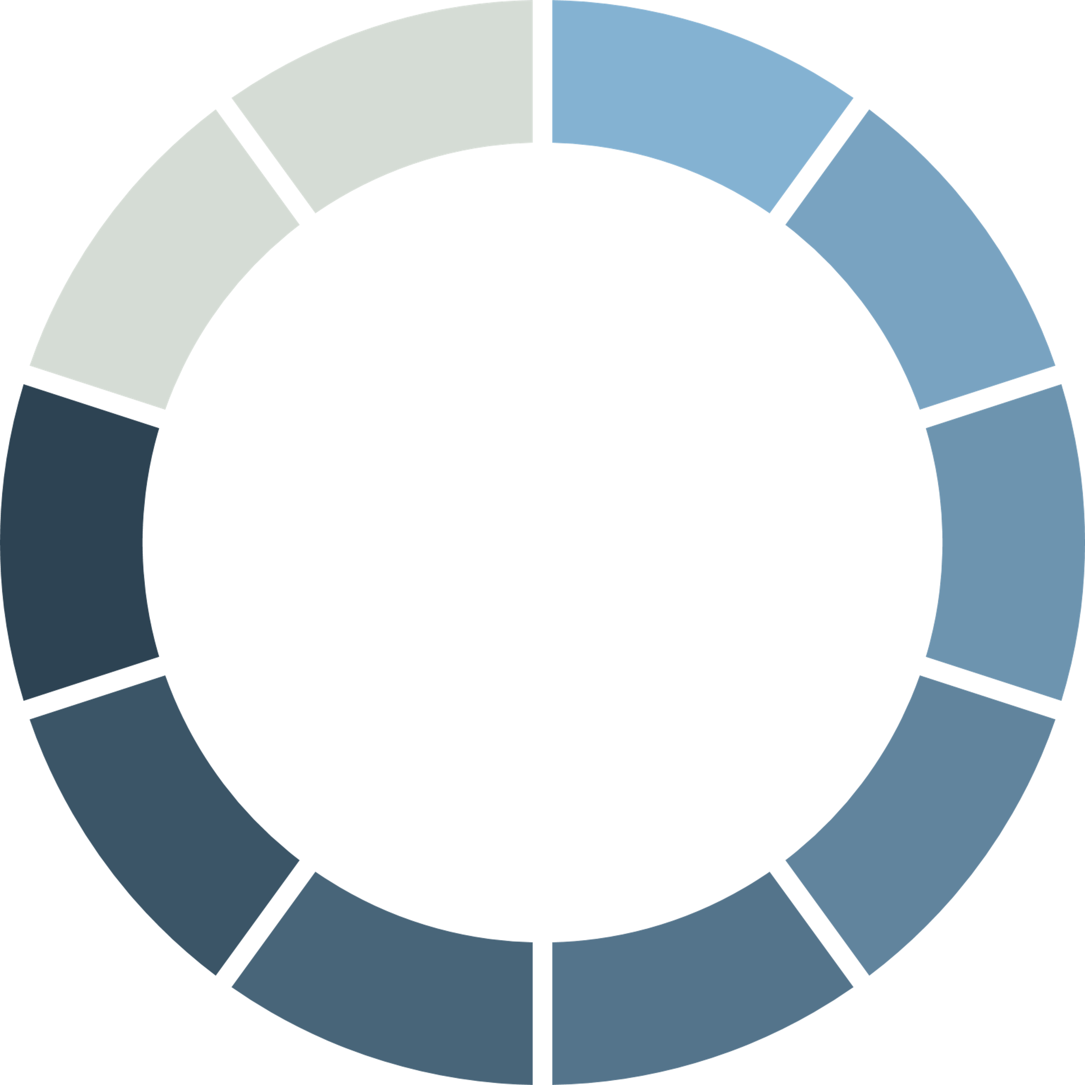
86% of buyers will pay more for a better customer experience.
85% of customers will manage its relationship with an enterprise without interacting with a human
85%
Source: Gartner

Slide 5







Brand – Customer Communication Maturity
Single Channel
Multi Channel
Cross Channel
Omni Channel
Brick & Mortar
Multi-Channel
Omni-Channel

Slide 6
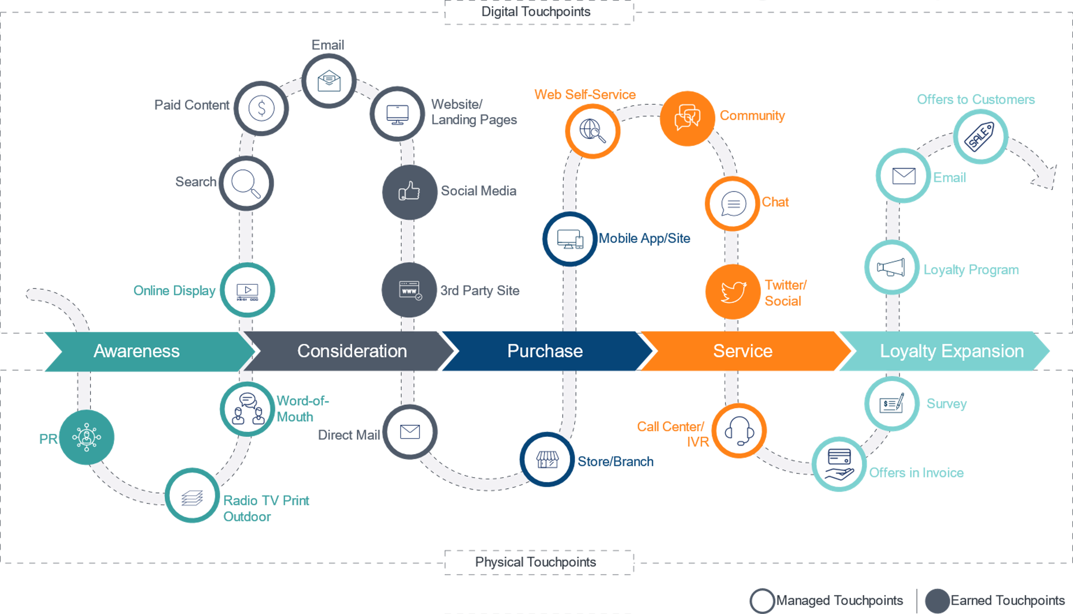
Customer Information Across Channels

Slide 7
Journey of Multi-Channel Experience towards Omni-Channel Experience
Customer Outcomes
+
Customer Experience
Customer Success =
Increased Repeat Business
Improved Average Order Value (AOV)
Better Life-Time-Value (LTV)

Slide 8
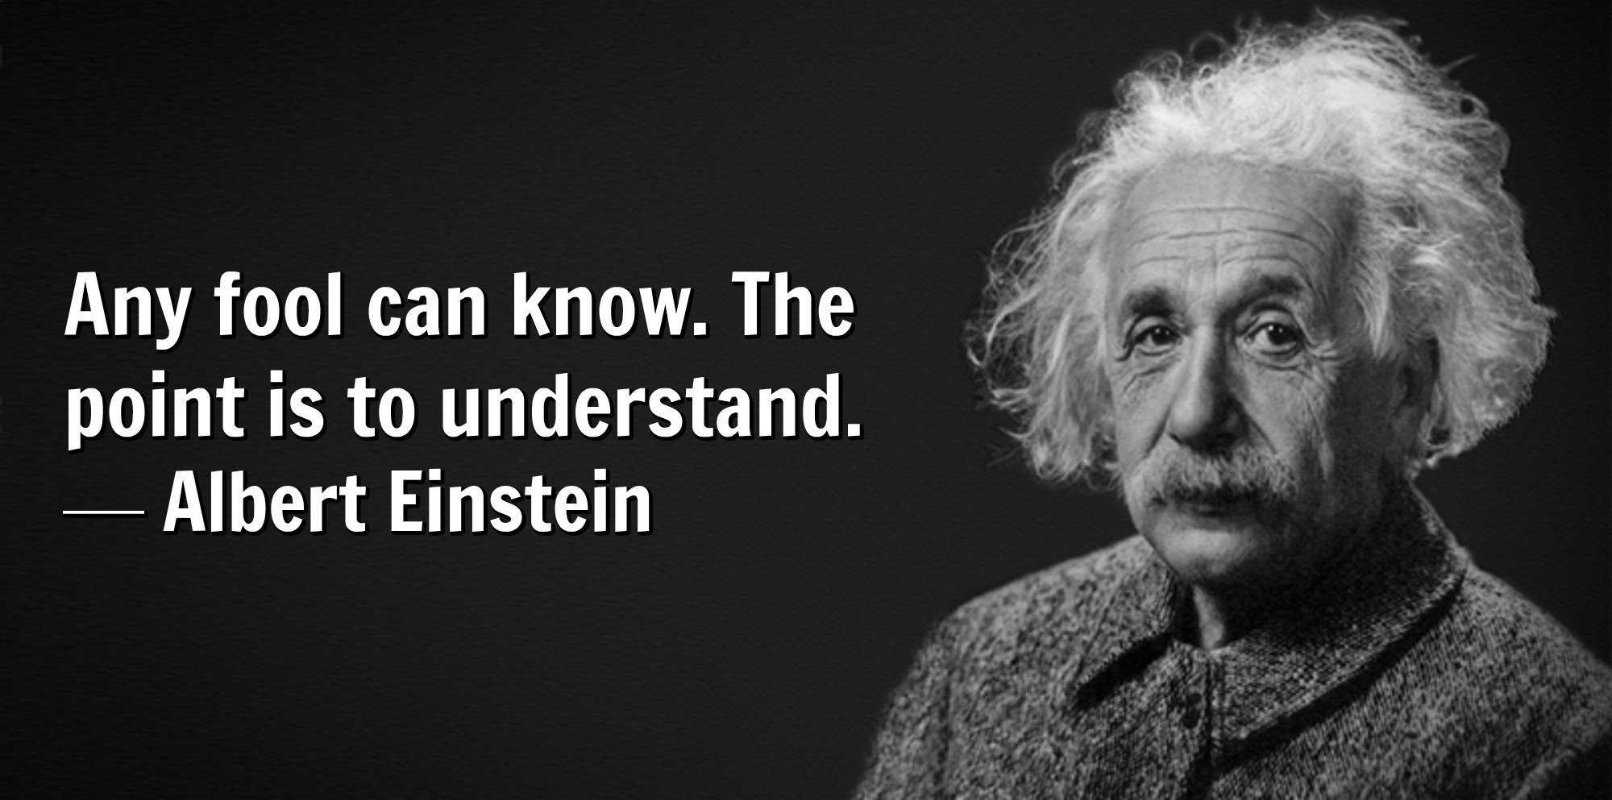

Slide 9










CRM Then & Now
Saas / CRM On Cloud
CRM on Mobile
Data Intelligence
CRM on Premises
Database
Data Collaboration
Ledger
Data Collection

Slide 10
The Standard CRM
A typical CRM manages customer data which can be used to analyze and make informed decisions, drive sales and engage with customers
It brings together
Marketing
Sales
Customer Service departments

Slide 11
The Future!
Customer experience (CX) involves
Listening to customers,
Analyzing their buying trends,
Feedback analysis from various sources,
In Store experience,
Post buying experience
Personalization has become the key for gaining customer loyalty and improving brand value
Read – 16 Top Customer Experience takeaways

Slide 12


















Why Dynamics 365 ?
Sales
Marketing
Voice of Customer
Forms
Social
Engagement
Retail
Customer Service
Talent
Microsoft Dynamics 365
CRM
ERP
Field Service
Finance and Operations
Project Service Automation
Flow
Power BI
Power App
CDS

Slide 13
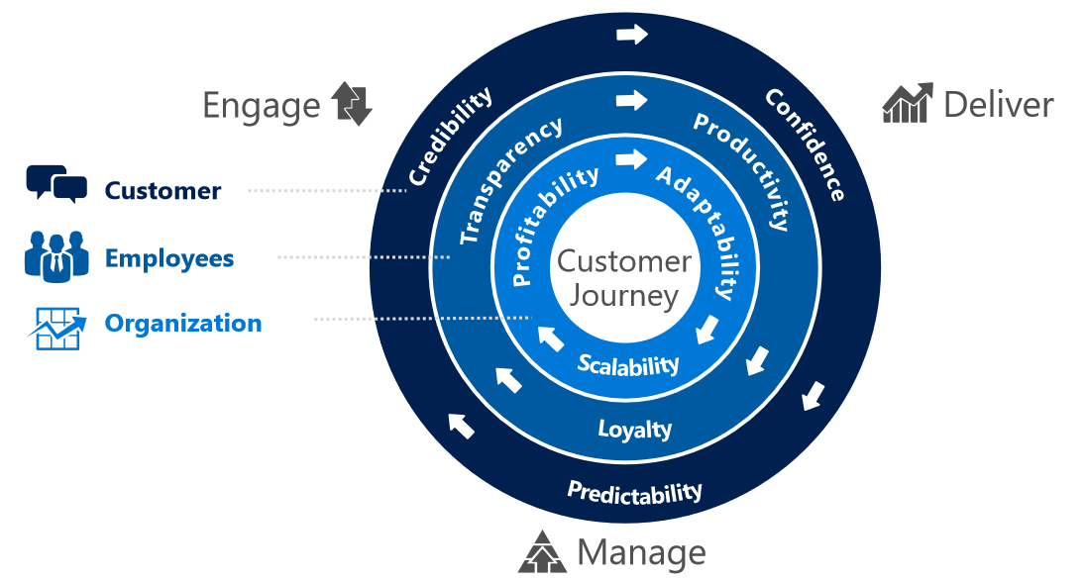
Customer Experience

Slide 14
D365 CE – Key to Customer Experience
Event
Portal
Partner
Portal
D365 for Marketing
D365 for Sales
D365 for Customer Service
Forms
Flow
Social Engagement
Field Service
LinkedIn Leads Gen
IoT
Azure
ERP+
Retail
Portals Customer Service
CFS

Slide 15
Limitations
CDS is still evolving – Most of the integrations are still being done through web services or 3rd party tools
D365 CE has limited Pricing capabilities which increases the dependency on 3rd party add-ons or integration with an ERP
Limited Taxation functionality – Rely on 3rd party solutions
CFS + IOT – still a new thing

Slide 16
Upcoming
D365 + AI features
Dynamics 365 Customer Insights
Dynamics 365 Virtual Agent for Customer Service
Dynamics 365 Fraud Protection
D365 + Mixed reality
D365 Product Visualize (coming to iOS in preview)
D365 Remote Assist for mobile devices (coming to Android in preview)
Learn More

Slide 17


Slide 18
Thank You
For further details please contact Krishnam.nagapuri@columbusglobal.com

